Slide 1

SE401 - Software Quality Assurance and Testing
Test Cases

Slide 2
Thought for the Day
Programs need not be idiot proof. Idiots don’t use programs.

Slide 3
Outline
Testing
Test selection
Writing test cases
Test Execution

Slide 4
Testing
There is a massive misunderstanding about testing: that it improves software. It doesn't!
Weighing yourself doesn't reduce your weight; going to the doctor doesn't make you healthy. Those things help to identify problems that you might choose to resolve. Testing does too.
The testing does not make the product better, even though it's part of a process that does make a product better.
Testing does not improve quality unless something else changes. What testing *does* do is to provide us with awareness of the status of the product, whereupon people may decide (or not) to improve its quality.

Slide 5
Test selection

Slide 6
Test cases
A test case, is a set of conditions under which a tester will determine whether an application, software system or one of its features is working as it was originally established for it to do.
Test cases are often referred to as test scripts, particularly when written – when they are usually collected into test suites.
A Test Case is a set of actions executed to verify a particular feature or functionality of your software application.

Slide 7
Test cases
A test case is a description of a specific interaction that a tester will have in order to test a single behavior of the software.
Test cases are very similar to use cases, in that they are step-by-step narratives which define a specific interaction between the user and the software.
A typical test case is laid out in a table, and includes:
A unique name and number
A requirement which this test case is exercising
Preconditions which describe the state of the software before the test case
Steps that describe the specific steps which make up the interaction
Expected Results which describe the expected state of the software after the test case is executed

Slide 8
Test cases
Test cases must be repeatable.
Good test cases are data-specific, and describe each interaction necessary to repeat the test exactly.

Slide 9
Writing test cases
First you must understand the language fundamentals
Sizes and limits of variables, platform specific information
Second, you must understand the domain
Read the requirements
Think like a user – what possible things do they want to do
Think about possible “mistakes”; i.e. Invalid input
Think about impossible conditions or input
What is the testing intended to prove?
Correct operation – gives correct behavior for correct input
Robustness – responds to incorrect or invalid input with proper results
User acceptance – typical user behavior
Write down the test cases

Slide 10
Writing Good Test Cases
Test Cases need to be simple and transparent:
Create Test Case with end user in mind
Avoid test case repetition.
Do not Assume
Stick to the Specification Documents.
Ensure 100% Coverage
Test Cases must be identifiable.
Implement Testing Techniques
It's not possible to check every possible condition in your software application.
Testing techniques help you select a few test cases with the maximum possibility of finding a defect.

Slide 11
Writing Good Test Cases
Boundary Value Analysis (BVA):
testing of boundaries for specified range of values.
Repeatable and self-standing
The test case should generate the same results every time no matter who tests it

Slide 12
Writing a test case
While drafting a test case do include the following information
The description of what requirement is being tested
Inputs and outputs or actions and expected results
Test case must have an expected result.
Verify the results are correct
Testing Normal Conditions
Testing Unexpected Conditions
Bad (Illegal) Input Values
Boundary Conditions

Slide 13
Writing test cases
Cover all possible valid input
Try multiple sets of values, not just one set of values
Permutations of values
Check boundary conditions
Check for off-by-one conditions
Check invalid input
Illegal sets of value
Illegal input
Impossible conditions
Totally bad input
Text vs. Numbers, etc.

Slide 14
Writing test cases
Let’s consider the triangle example
Cover all possible valid input
all three possible conditions: equilateral, isosceles, scalene
Try multiple sets of values, not just one set of values
Permutations of values {3,4,5}, {4,3,5}, {5,4,3}
Check boundary conditions
Check for off-by-one conditions: 0, MAX_INT
Check invalid input
Illegal sets of value
Wrong format: not integer
Negative numbers
Illegal input
Impossible conditions: {2,3,8}, {2,3,5} {definition of a triangle}
Totally bad input
Text vs. Numbers, etc.

Slide 15
Writing test cases
Beware of problems with comparisons
How to compare two floating numbers
Never do the following: float a, b; . . . if ( a == b)
Is it 4.0000000 or 3.9999999 or 4.0000001 ?
What is your limit of accuracy?
In object oriented languages make sure whether you are comparing the contents of an object or the reference to an object
String a = “Hello world!\n”
String b = “Hello world!\n”
if ( a == b )
vs.
if ( a.equals(b) )

Slide 16
Writing test cases
Let’s consider the triangle example
How to test the code?
Have the code read from the standard input
java Triangle < testcases.txt or,
java Triangle 2 3 3 3 4 5
Have the output print to standard output.
java Triangle > results.txt
Combine the two and we have:
java Triangle <testcases.txt >results.txt
This assumes we have the code read three numbers on the line, or have the code read three numbers whether they are on one line or more.

Slide 17
Tips for testing
You cannot test every possible input, parameter value, etc.
So you must think of a limited set of tests likely to expose bugs.
Think about boundary cases
positive; zero; negative numbers; infinity; very small
right at the edge of an array or collection's size (plus or minus one)
Think about empty cases and error cases
0, -1, null; an empty list or array
test behavior in combination
maybe add usually works, but fails after you call remove
make multiple calls; maybe size fails the second time only

Slide 18
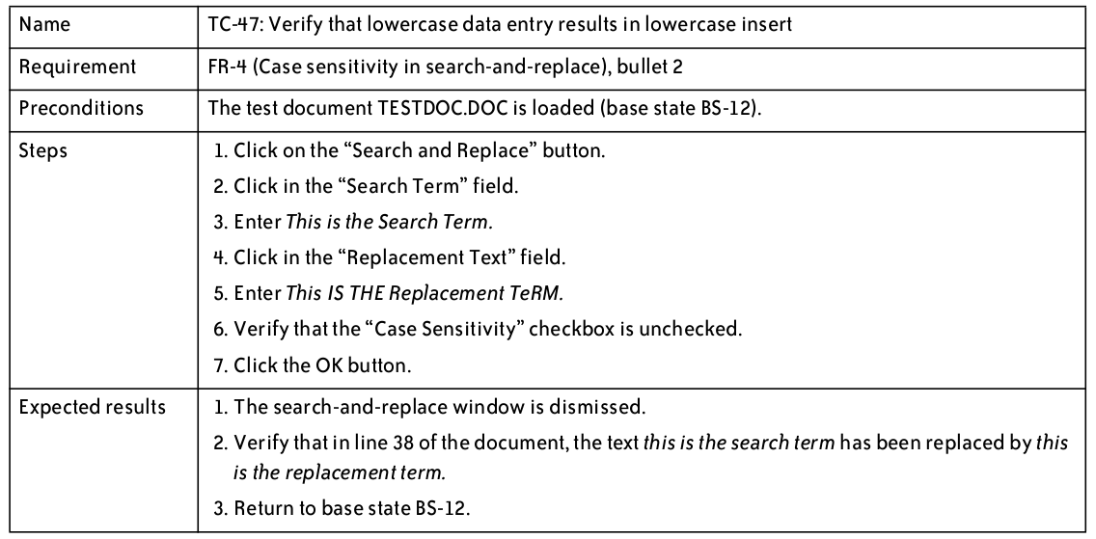
Test Cases – Good Example

Slide 19
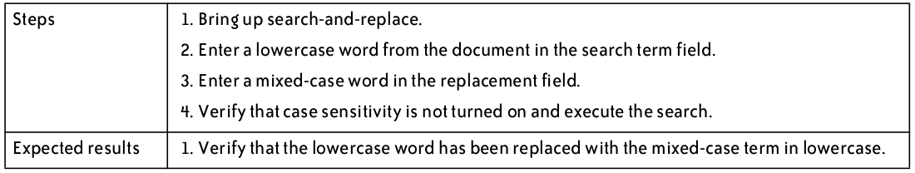
Test Cases – Bad Example

Slide 20
Test cases
Why we write test cases?
The basic objective of writing test cases is to validate the testing coverage of the application.
Keep in mind while writing test cases that all your test cases should be simple and easy to understand.
For any application basically you will cover all the types of test cases including functional, negative and boundary value test cases.

Slide 21
Trustworthy tests
Test one thing at a time per test method.
10 small tests are much better than 1 test 10x as large.
Each test method should have few (likely 1) assert statements.
If you assert many things, the first that fails stops the test.
You won't know whether a later assertion would have also failed.
Tests should avoid logic.
minimize if/else, loops, switch, etc.
avoid try/catch
If it's supposed to throw, use expected= ... if not, let JUnit catch it.
Torture tests are okay, but only in addition to simple tests.

Slide 22
Test Execution
The software testers begin executing the test plan after the developers deliver the alpha build, or a build that they feel is feature complete.
The alpha should be of high quality—the developers should feel that it is ready for release, and as good as they can get it.
There are typically several iterations of test execution.
The first iteration focuses on new functionality that has been added since the last round of testing.
A regression test is a test designed to make sure that a change to one area of the software has not caused any other part of the software which had previously passed its tests to stop working.
Regression testing usually involves executing all test cases which have previously been executed.
There are typically at least two regression tests for any software project.

Slide 23
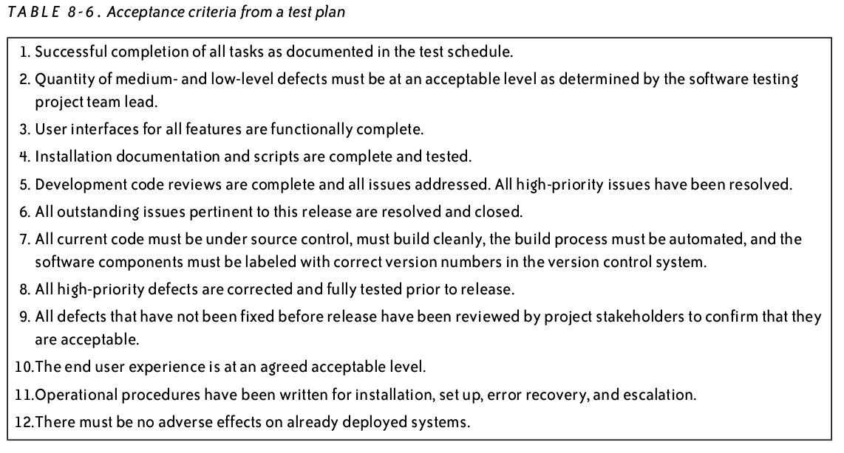
Test Execution
When is testing complete?
No defects found
Or defects meet acceptance criteria outlined in test plan

Slide 24
Automating Test Execution
Designing test cases and test suites is creative
Like any design activity: A demanding intellectual activity, requiring human judgment
Executing test cases should be automatic
Design once, execute many times
Test automation separates the creative human process from the mechanical process of test execution

Slide 25
Generation: From Test Case Specifications to Test Cases
Test design often yields test case specifications, rather than concrete data
Ex: “a large positive number”, not 420023
Ex: “a sorted sequence, length > 2”, not “Alpha, Beta, Chi, Omega”
Other details for execution may be omitted
Generation creates concrete, executable test cases from test case specifications

Slide 26
Scaffolding
Code produced to support development activities (especially testing)
Not part of the “product” as seen by the end user
May be temporary (like scaffolding in construction of buildings)
Includes
Test harnesses, drivers, and stubs
Example:
JUnit – test harness
Eclipse – IDE, scaffolding, JUnit built in

Slide 27
Scaffolding ...
Test driver
A “main” program for running a test
May be produced before a “real” main program
Provides more control than the “real” main program
To drive program under test through test cases
Test stubs
Substitute for called functions/methods/objects
Test harness
Substitutes for other parts of the deployed environment
Ex: Software simulation of a hardware device
Notes:
Terminology note: “Harness” is also commonly used to refer to all three parts, a test driver, stubs, and replacements for other components.

Slide 28
Stubs

Slide 29
Drivers

Slide 30
Generic or Specific?
How general should scaffolding be?
We could build a driver and stubs for each test case
... or at least factor out some common code of the driver and test management (e.g., JUnit)
... or further factor out some common support code, to drive a large number of test cases from data (as in DDSteps)
... or further, generate the data automatically from a more abstract model (e.g., network traffic model)
A question of costs and re-use
Just as for other kinds of software
Notes:
DDSteps is a JUnit extension for building data driven test cases.

Slide 31
Oracles
Did this test case succeed, or fail?
No use running 10,000 test cases automatically if the results must be checked by hand!
Range of specific to general, again
ex. JUnit: Specific oracle (“assert”) coded by hand in each test case
Typical approach: “comparison-based” oracle with predicted output value
Not the only approach!

Slide 32
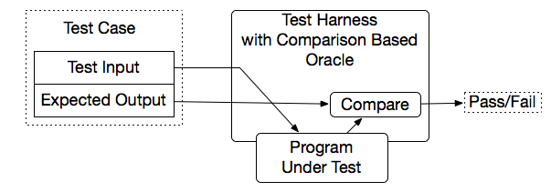
Comparison-based oracle
With a comparison-based oracle, we need predicted output for each input
Oracle compares actual to predicted output, and reports failure if they differ
Fine for a small number of hand-generated test cases
E.g., for hand-written JUnit test cases

Slide 33
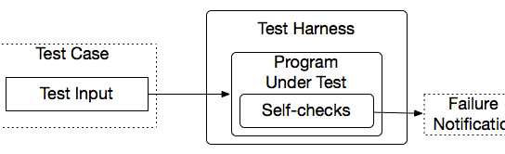
Self-Checking Code as Oracle
An oracle can also be written as self-checks
Often possible to judge correctness without predicting results
Advantages and limits: Usable with large, automatically generated test suites, but often only a partial check
e.g., structural invariants of data structures
recognize many or most failures, but not all
Notes:
A typical approach is to add a few hand-written test cases with a comparison-based test oracle, to cover properties that are difficult or too expensive to check with a general oracle.

Slide 34
Capture and Replay
Sometimes there is no alternative to human input and observation
Even if we separate testing program functionality from GUI, some testing of the GUI is required
We can at least cut repetition of human testing
Capture a manually run test case, replay it automatically
with a comparison-based test oracle: behavior same as previously accepted behavior
reusable only until a program change invalidates it
lifetime depends on abstraction level of input and output

Slide 35
Defect Tracking
The defect tracking system records and tracks defects.
It routes each defect between testers, developers, the project manager and others, following a workflow designed to ensure that the defect is verified and repaired.
Every defect encountered in the test run is recorded and entered into a defect tracking system so that it can be prioritized.
The defect workflow should track the interaction between the testers who find the defect and the developers who fix it.
It should ensure that every defect can be properly prioritized and reviewed by all of the stakeholders to determine whether or not it should be repaired. This process of review and prioritization referred to as triage.

Slide 36
Smoke Tests
A smoke test is a subset of the test cases that is typically representative of the overall test plan.
Smoke tests are good for verifying proper deployment or other non invasive changes.
They are also useful for verifying a build is ready to send to test.
Smoke tests are not substitute for actual functional testing.

Slide 37
Summary
Goal: Separate creative task of test design from mechanical task of test execution
Enable generation and execution of large test suites
Re-execute test suites frequently (e.g., nightly or after each program change)
Scaffolding: Code to support development and testing
Test drivers, stubs, harness, including oracles
Ranging from individual, hand-written test case drivers to automatic generation and testing of large test suites
Capture/replay where human interaction is required

